Slide 1



BUSINESS INTELLIGENCE
NBA GAMES
NBA Game Winner Predictions For Home Games
By: Evan Winter, Jamison Stutzman, Nick Perry, and Baylor Van Sickle

Slide 2

Home
INTRODUCTION
The Why: We want to even information disparity through predictions of NBA Games outcomes
The Problem: Information disparity creates uneven sports betting environments with inaccurate betting lines
Potential End Users: NBA Executives, Sports Betting Brokers, Sports Bettors
Goals:
Compare home vs. away game results for thousands of NBA games each season
Creating accurate betting lines to better inform the average consumer
Build a predictive model to forecast game outcomes based on key metrics

Slide 3

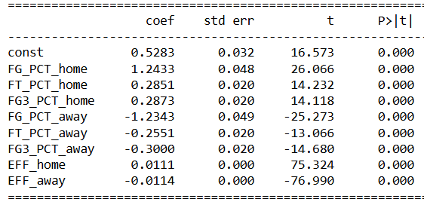
ABOUT OUR DATA
This dataset contains detailed information about NBA games over multiple seasons.
Key Columns:
home_win – Indicates if the home team won (1 = win, 0 = loss)
fg / fg3 / ft – Field goals, 3-point shots, free throws percentage
ast / reb – Assists and rebounds for both teams
Efficiency - Points + Rebounds + Assists (H/A)
Top 5 Features - EFF (H/A), FG%(H/A), 3Pt% (H)
Data Leak:
Pts scored by Home and Away Teams
Multicollinearity Issue:
Many of our variables were highly correlated
We combined the highest into one variable

Slide 4
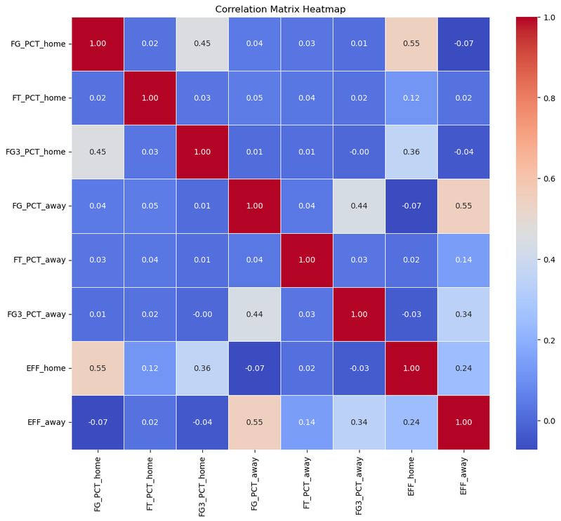
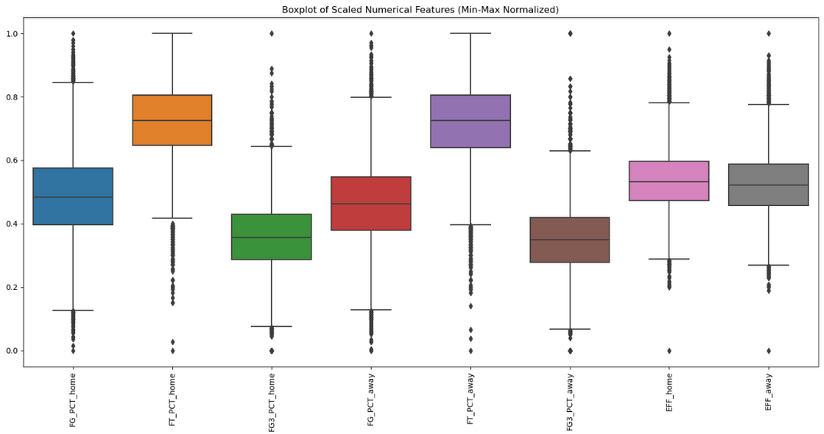
ANALYSIS
Correlation Matrix HeatMap
Our heatmap shows correlation between variables, of which the efficiency, fg%, and fg3% are the most correlated. This shows that as the efficiency of a team goes up, so does their fg% and their 3-pt %. Knowing which factors move together is crucial to developing an accurately predictive model.
Boxplots
Similar boxplots suggest evenly distributed numerical stats, while outliers reveal unusual games. Features with more spread may be more predictive, helping us refine data before modeling.
Histograms
Histograms show how often values occur, allowing us to identify whether the data is normally distributed or skewed.

Slide 5
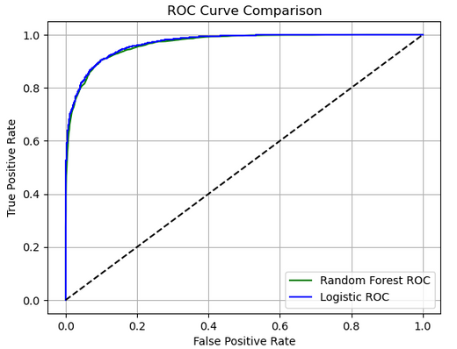
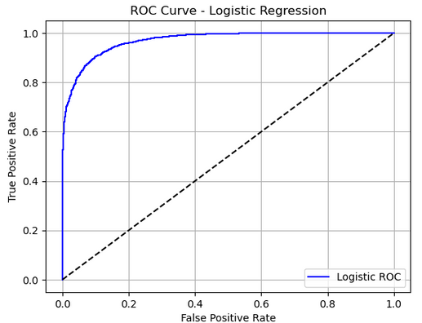
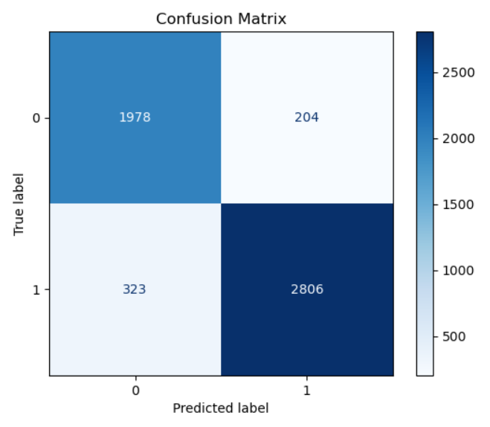
MODELING
Logistical Regression
Our logistical regression charts display how well the model sees the difference between home team wins and loses. The AUC for this model is 0.96 meaning that 96% of the time the model correctly guesses the outcome of the game based on the pregame statistics.
Confusion Matrix
Our confusion matrix shows a value of 1,978 correctly predicted losses and 2,806 correctly predicted wins.. This is compared to 204 incorrectly predicted wins and 323 incorrectly predicted losses. Our model got 93% of wins correct and 86% of losses correct for a total of 90% correct predictions.

Slide 6

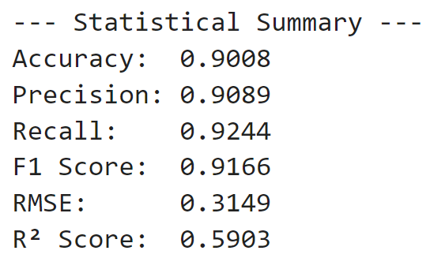

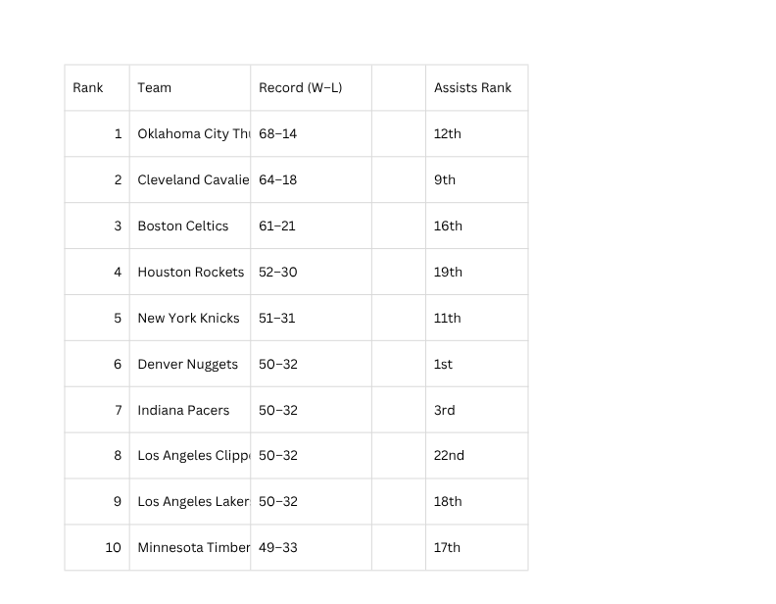
INSIGHTS
6.1 Statistical Summary • Recap model metrics and behavior.
6.2 Business Insight • This model predicts the outcome of NBA home games based on
pre-game statistics. The top 5 features identified by the Random Forest strongly influence whether a home team will win helping the forecast be accurate.
Actionable insight: Coaches, analysts, or bettors can use these predictors to:
- Strategize lineups based on key predictive stats.
- Evaluate expected win probability before games.
- Optimize preparation strategies based on influential metrics.
6.3 Limitations • Mention data or model constraints.
- The dataset only includes player injuries, coaching decisions, or real-time events.
- The outcome is binary (win/loss) without accounting for point spread or margin.
- The model assumes all seasons are comparable; it does not correct for rule changes or roster shifts, and skill changes over time.
- Some correlations might be due to multicollinearity, which could affect models.
6.4 Future Work • Suggest improvements or further research.
- Add factors such as rest time, travel distance of the opponent, etc.
- Incorporate advanced player-level stats to refine predictions.
- Extend the model to away games or betting spreads for broader use.
.
Interestingly, we found that assists are the least impactful factor tested, which is supported by the fact that the best teams in the NBA in 2024/25 are around the middle of teams in total assists!

Slide 7

BUSINESS INTELLIGENCE
THANK YOU

